Slide 1
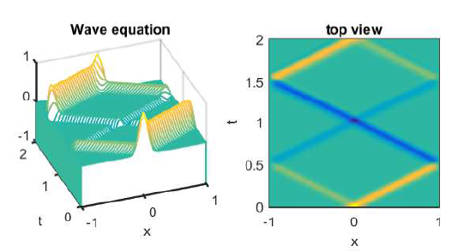
Chapter 12 Advection equations

Slide 2
Advection equations
In Chapter 11, we saw IVBPs where the essential behavior was smoothing, as characterized by the heat equation
Exponential decay appeared explicitly example exact solution
Energy was dissipated
For advection equations, we have different qualitative behavior
Solutions propagate, not decay
Energy is conserved

Slide 3
Advection equations
Despite the differences in exact solution behavior there are commonalities
There are space and time variables
The method of lines approach will serve us well in this case also
We will start with first order wave equations, then proceed to a second order wave equation

Slide 4
Section 12.1 Traffic flow

Slide 5
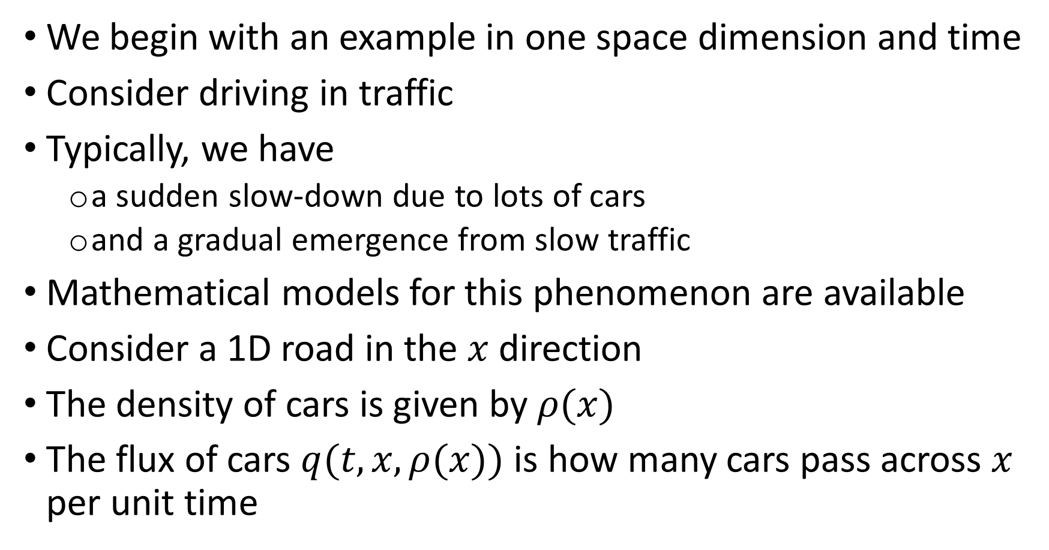
Traffic flow
We begin with an example in one space dimension and time
Consider driving in traffic
Typically, we have
a sudden slow-down due to lots of cars
and a gradual emergence from slow traffic
Mathematical models for this phenomenon are available
Consider a 1D road in the $x$ direction
The density of cars is given by $ρ(x)$
The flux of cars $q(t,x,ρ(x))$ is how many cars pass across $x$ per unit time

Slide 6

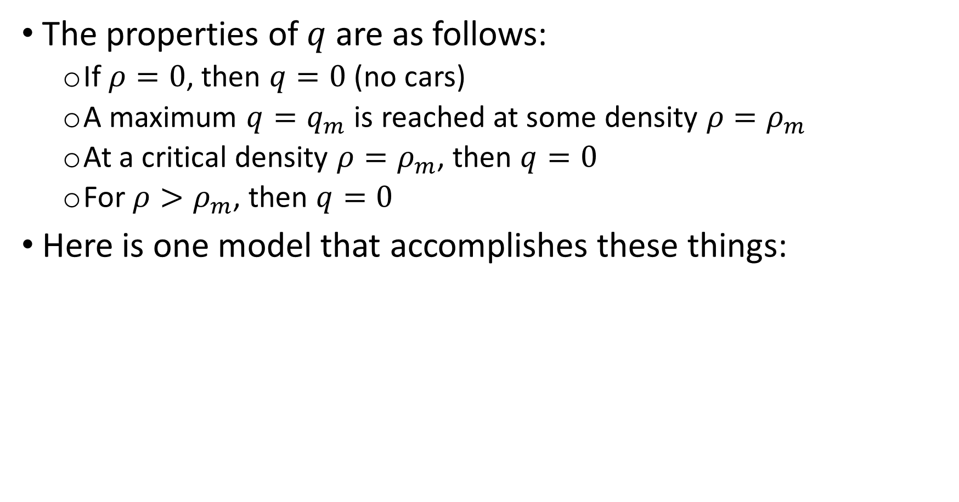
Traffic flow
The properties of $q$ are as follows:
If $ρ=0$, then $q=0$ (no cars)
A maximum $q=q_{m}$ is reached at some density $ρ=ρ_{m}$
At a critical density $ρ=ρ_{m}$, then $q=0$
For $ρ>ρ_{m}$, then $q=0$
Here is one model that accomplishes these things:

Slide 7
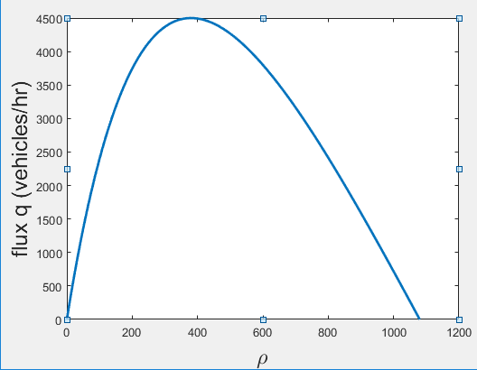
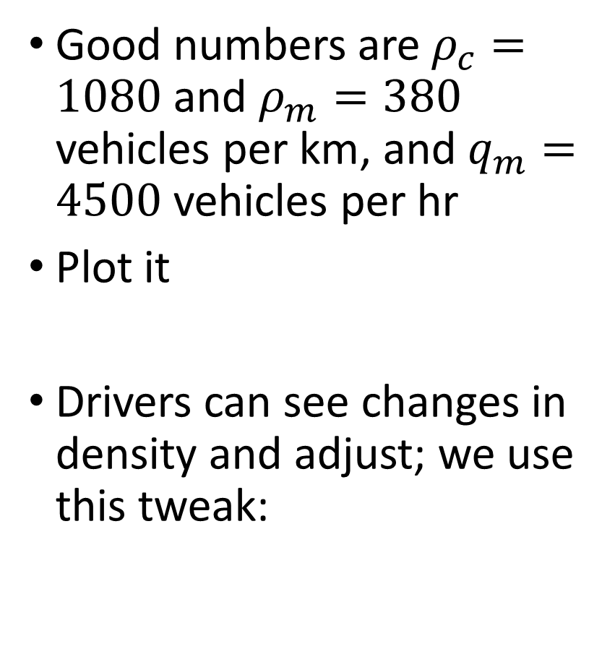
Traffic flow
Good numbers are $ρ_{c}=1080$ and $ρ_{m}=380$ vehicles per km, and $q_{m}=4500$ vehicles per hr
Plot it
Drivers can see changes in density and adjust; we use this tweak:

Slide 8
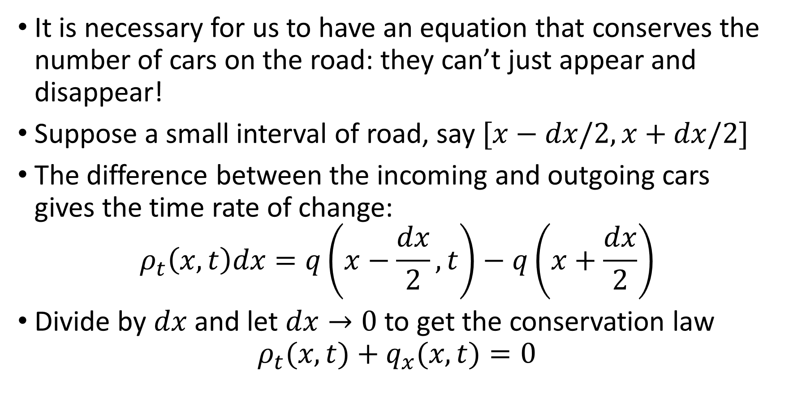
Conservation laws and hyperbolic equations
It is necessary for us to have an equation that conserves the number of cars on the road: they can’t just appear and disappear!
Suppose a small interval of road, say $[x−dx/2,x+dx/2]$
The difference between the incoming and outgoing cars gives the time rate of change:
$$ρ_{t}\left(x,t\right)dx=q\left(x−\frac{dx}{2},t\right)−q\left(x+\frac{dx}{2}\right)$$
Divide by $dx$ and let $dx→0$ to get the conservation law
$$ρ_{t}(x,t)+q_{x}(x,t)=0$$

Slide 9
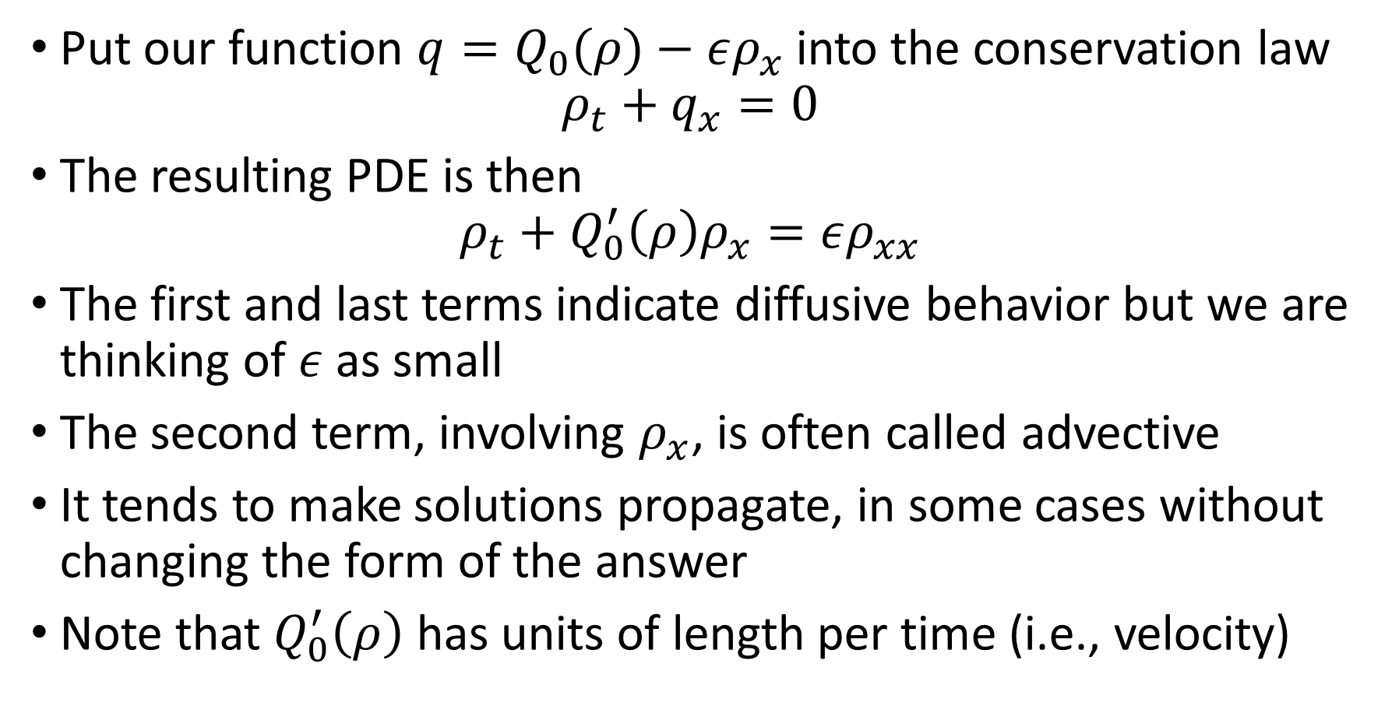
Conservation laws and hyperbolic equations
Put our function $q=Q_{0}(ρ)−ερ_{x}$into the conservation law
$$ρ_{t}+q_{x}=0$$
The resulting PDE is then
$$ρ_{t}+Q_{0}^{′}\left(ρ\right)ρ_{x}=ερ_{xx}$$
The first and last terms indicate diffusive behavior but we are thinking of $ε$ as small
The second term, involving $ρ_{x}$, is often called advective
It tends to make solutions propagate, in some cases without changing the form of the answer
Note that $Q_{0}^{′}\left(ρ\right)$ has units of length per time (i.e., velocity)

Slide 10
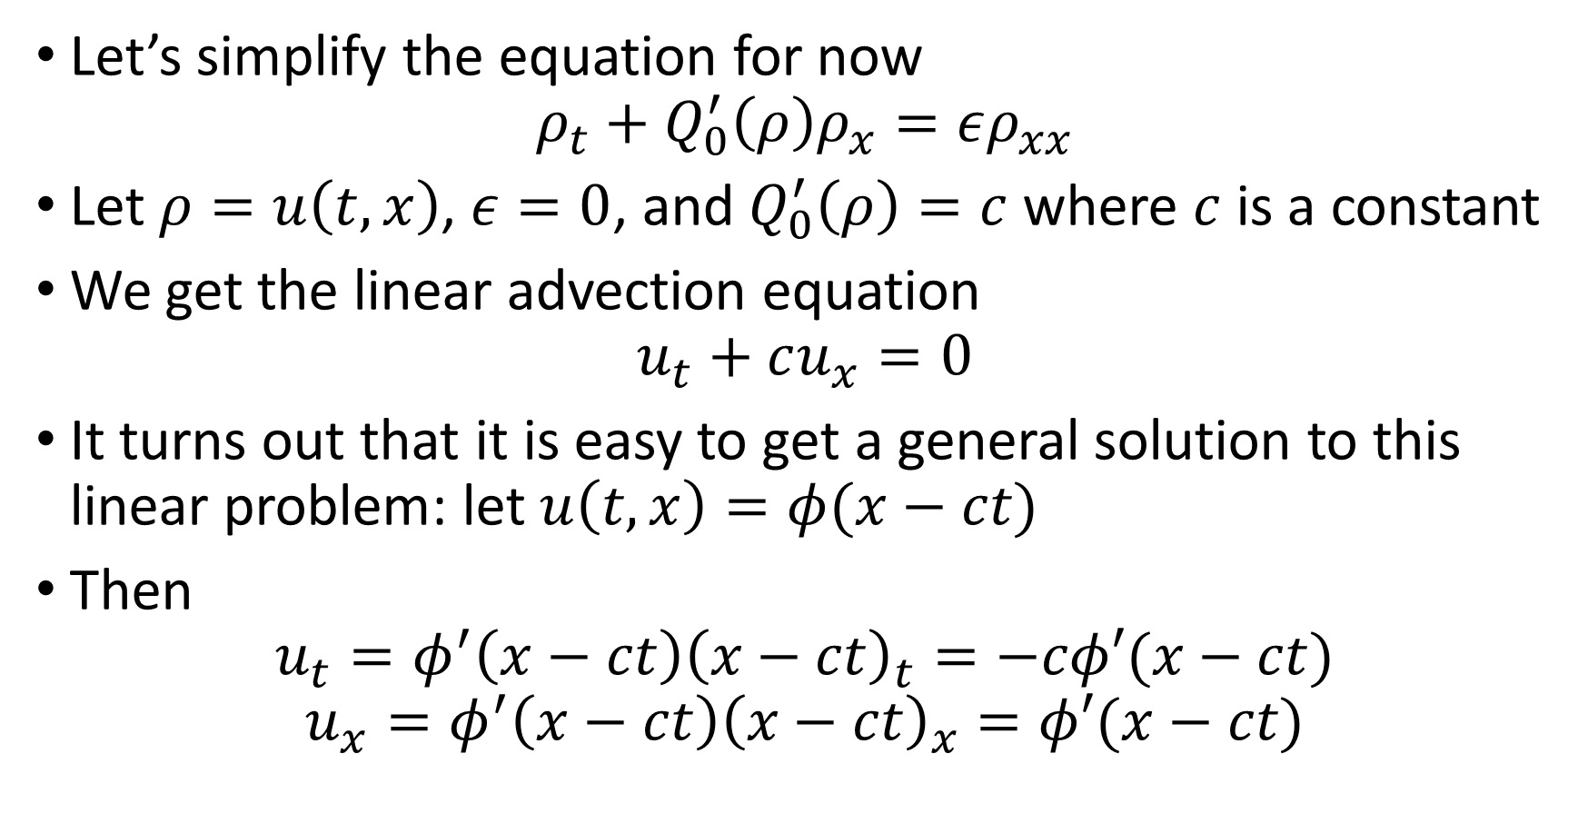
Conservation laws and hyperbolic equations
Let’s simplify the equation for now
$$ρ_{t}+Q_{0}^{′}\left(ρ\right)ρ_{x}=ερ_{xx}$$
Let $ρ=u\left(t,x\right)$, $ε=0$, and $Q_{0}^{′}\left(ρ\right)=c$ where $c$ is a constant
We get the linear advection equation
$$u_{t}+cu_{x}=0$$
It turns out that it is easy to get a general solution to this linear problem: let $u\left(t,x\right)=φ(x−ct)$
Then
$$u_{t}=φ^{′}\left(x−ct\right){\left(x−ct\right)}_{t}=−cφ′(x−ct)$$
$$u_{x}=φ^{′}\left(x−ct\right){\left(x−ct\right)}_{x}=φ′(x−ct)$$

Slide 11
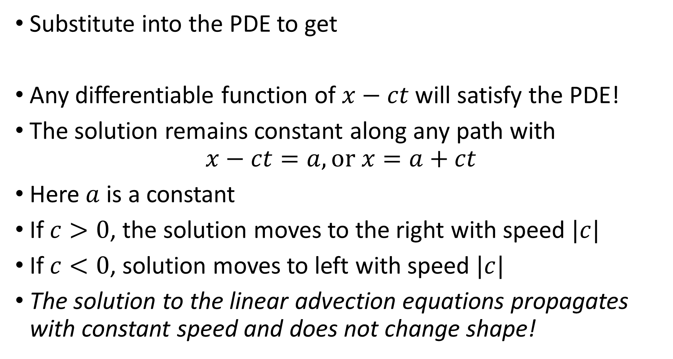
Conservation laws and hyperbolic equations
Substitute into the PDE to get
Any differentiable function of $x−ct$ will satisfy the PDE!
The solution remains constant along any path with
$$x−ct=a, or x=a+ct$$
Here $a$ is a constant
If $c>0$, the solution moves to the right with speed $|c|$
If $c<0$, solution moves to left with speed $|c|$
The solution to the linear advection equations propagates with constant speed and does not change shape!

Slide 12
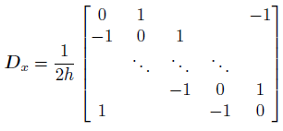
Conservation laws and hyperbolic equations
We now know a lot about solutions to the linear advection equation
Can we solve it accurately with a numerical approach?
Try a method of lines approach
Use a periodic domain (no BCs) and evenly spaced grid
Use Function 11.2.1 (diffper.m) again for space derivatives:

Slide 13



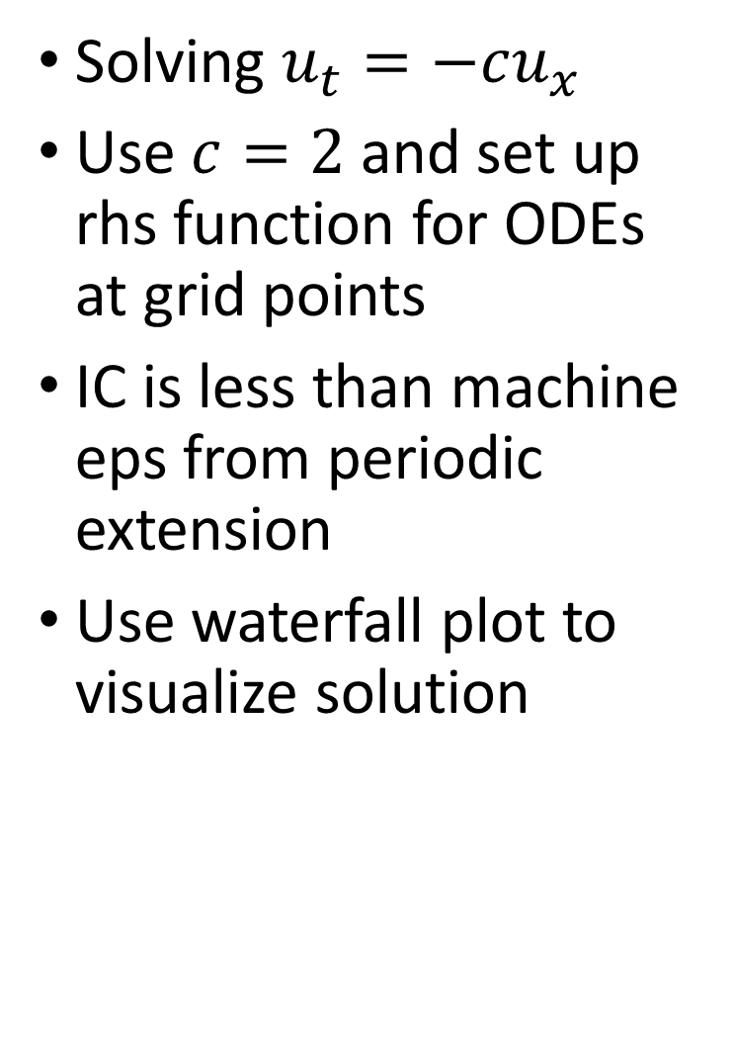
Example: linear advection+MOL
Solving $u_{t}=−cu_{x}$
Use $c=2$ and set up rhs function for ODEs at grid points
IC is less than machine eps from periodic extension
Use waterfall plot to visualize solution

Slide 14
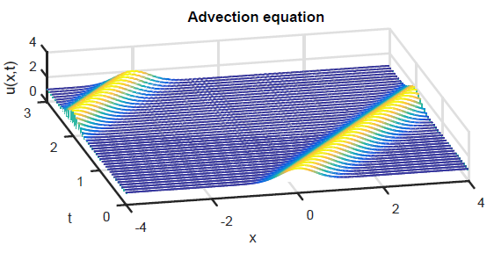
Example: linear advection+MOL
Solution moves to right with speed 2
Periodicity, what exits on the right enters at the left
Used ode45: the problem is not stiff (more later)

Slide 15
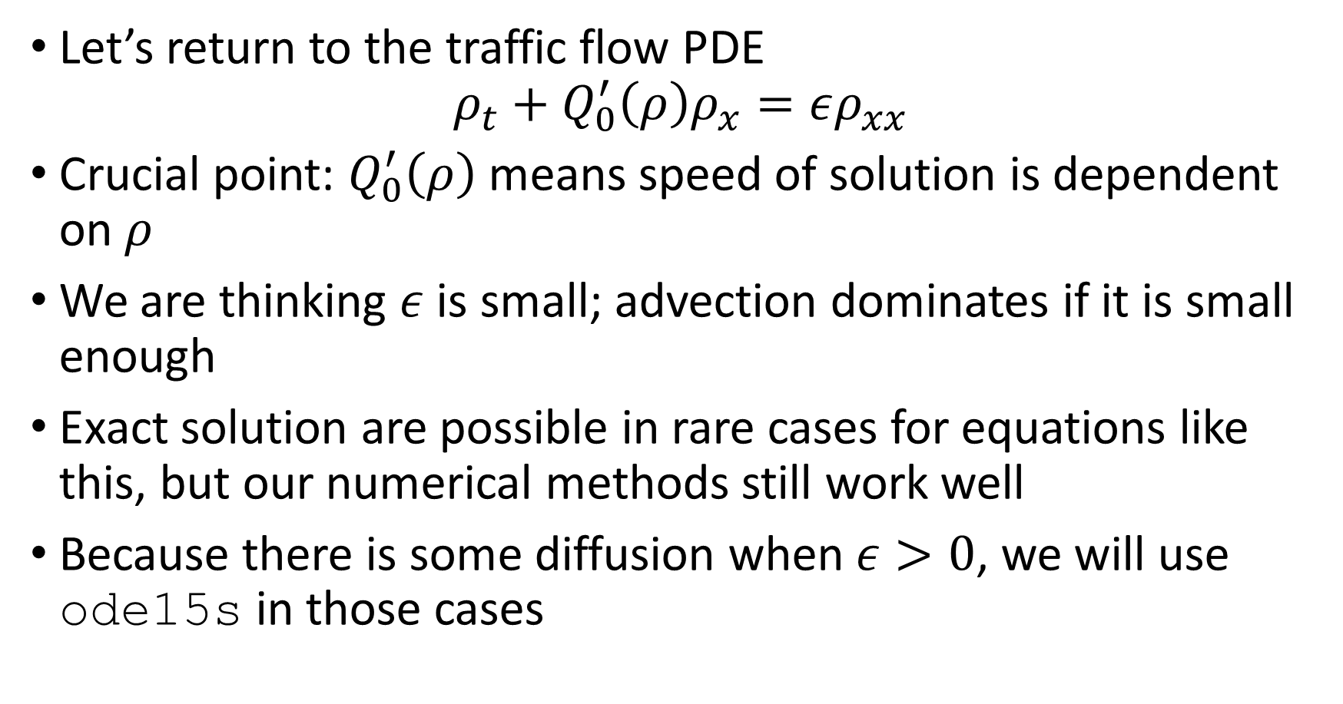
Solutions for traffic flow
Let’s return to the traffic flow PDE
$$ρ_{t}+Q_{0}^{′}\left(ρ\right)ρ_{x}=ερ_{xx}$$
Crucial point: $Q_{0}^{′}\left(ρ\right)$ means speed of solution is dependent on $ρ$
We are thinking $ε$ is small; advection dominates if it is small enough
Exact solution are possible in rare cases for equations like this, but our numerical methods still work well
Because there is some diffusion when $ε>0$, we will use ode15s in those cases

Slide 16


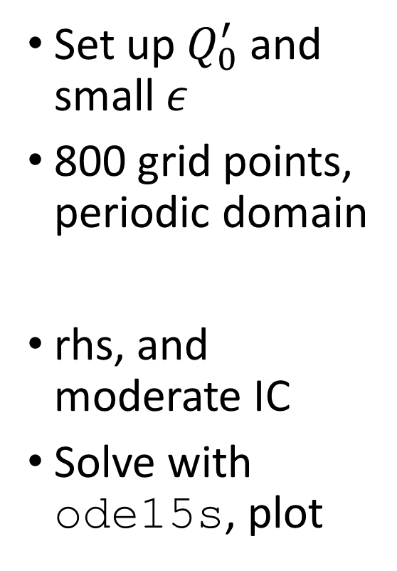
Example: traffic flow+MOL
Set up $Q_{0}^{′}$ and small $ε$
800 grid points, periodic domain
rhs, and moderate IC
Solve with ode15s, plot

Slide 17

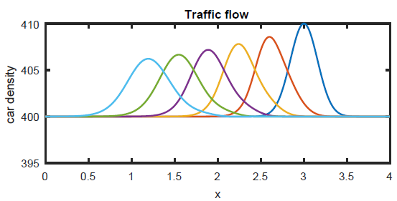
Example: traffic flow+MOL
Solution curves every unit time value
Local increase in density moves to left, smears out
Cars still moving to right, however

Slide 18

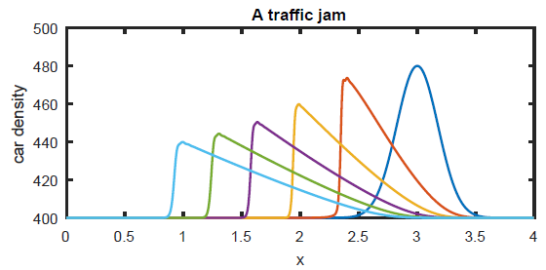
Example: traffic flow+MOL
Now with much larger initial bump
Bump still moves to left
Steepens at left end dramatically
“Sudden” increase in density there

Slide 19
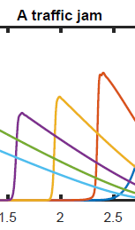
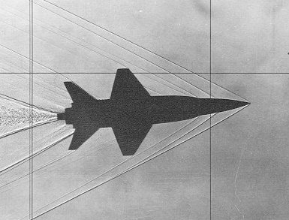
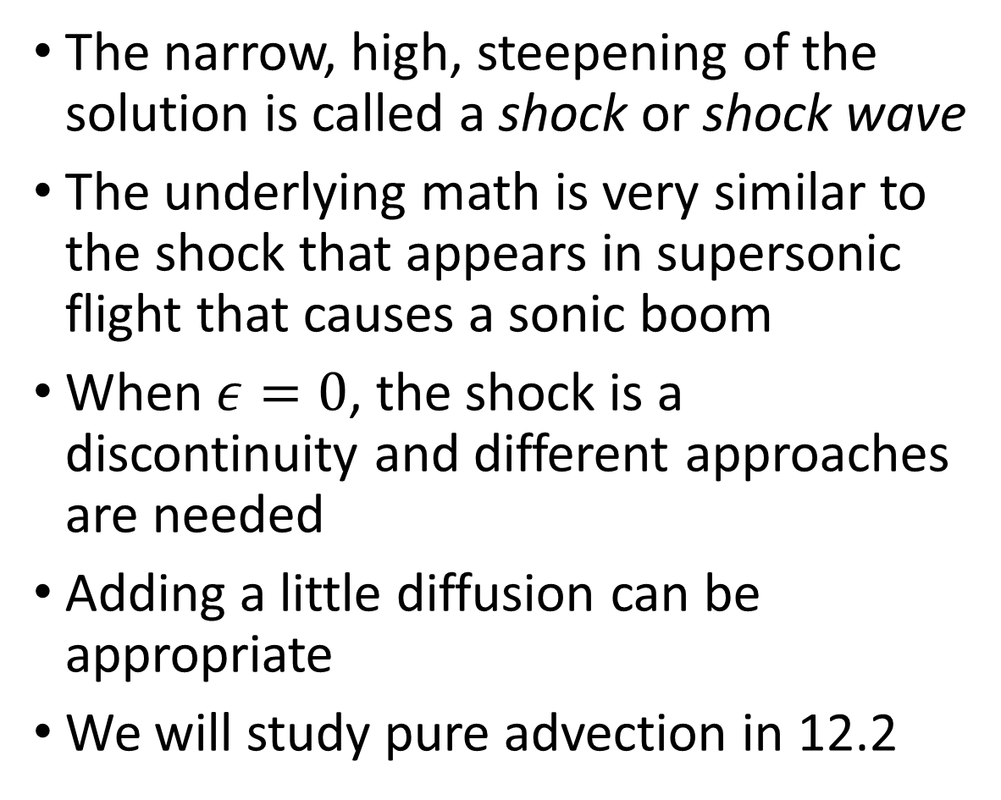
Solutions for traffic flow
The narrow, high, steepening of the solution is called a shock or shock wave
The underlying math is very similar to the shock that appears in supersonic flight that causes a sonic boom
When $ε=0$, the shock is a discontinuity and different approaches are needed
Adding a little diffusion can be appropriate
We will study pure advection in 12.2
X15 model, Mach 3.5, history.nasa.gov

Slide 20
Section 12.2 Upwinding and Stability

Slide 21
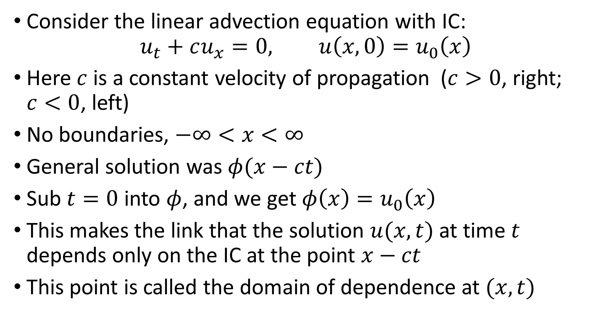
Upwinding and stability
Consider the linear advection equation with IC:
$$u_{t}+cu_{x}=0, u\left(x,0\right)=u_{0}\left(x\right)$$
Here $c$ is a constant velocity of propagation ($c>0$, right; $c<0$, left)
No boundaries, $−∞<x<∞$
General solution was $φ(x−ct)$
Sub $t=0$ into $φ$, and we get $φ\left(x\right)=u_{0}\left(x\right)$
This makes the link that the solution $u(x,t)$at time $t$ depends only on the IC at the point $x−ct$
This point is called the domain of dependence at $(x,t)$

Slide 22
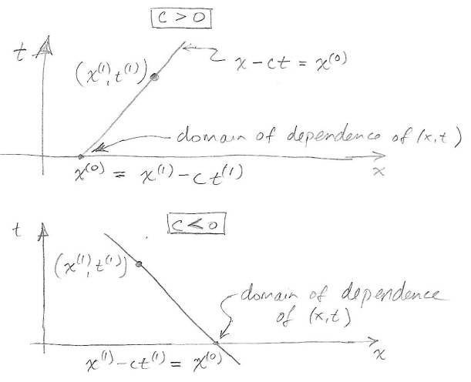
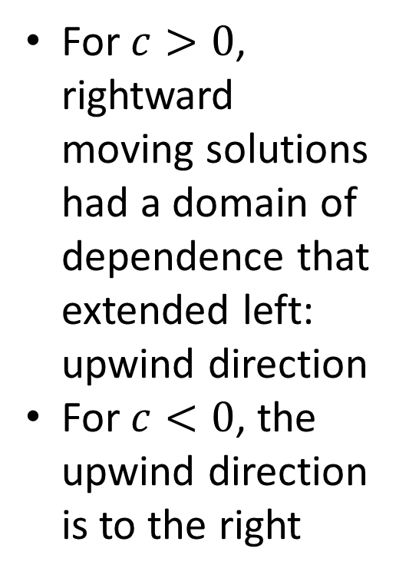
Conservation laws and hyperbolic equations
For $c>0$, rightward moving solutions had a domain of dependence that extended left: upwind direction
For $c<0$, the upwind direction is to the right

Slide 23


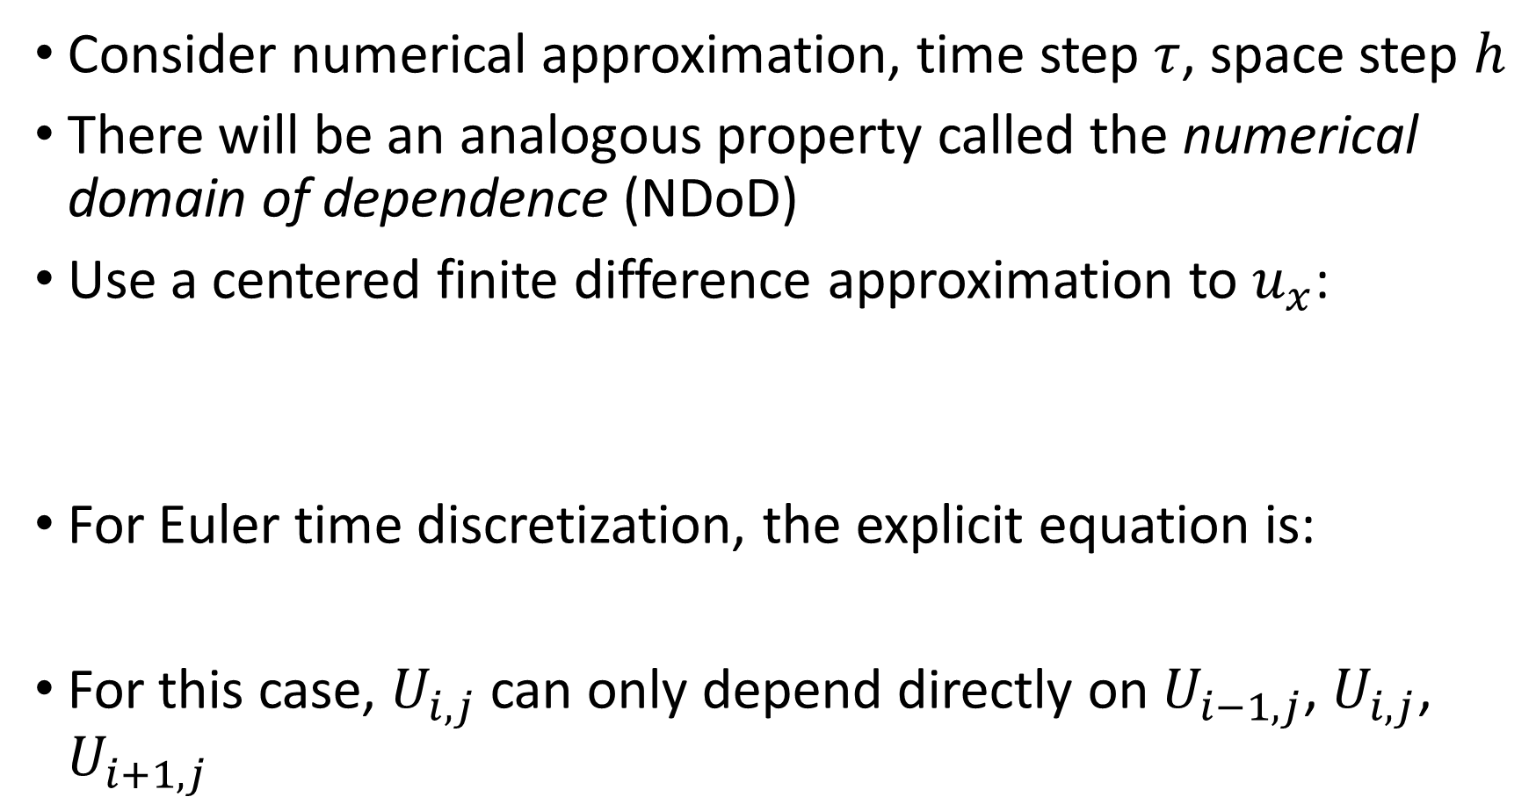
Upwinding and stability
Consider numerical approximation, time step $τ$, space step $h$
There will be an analogous property called the numerical domain of dependence (NDoD)
Use a centered finite difference approximation to $u_{x}$:
For Euler time discretization, the explicit equation is:
For this case, $U_{i,j}$ can only depend directly on $U_{i−1,j}$, $U_{i,j}$, $U_{i+1,j}$

Slide 24
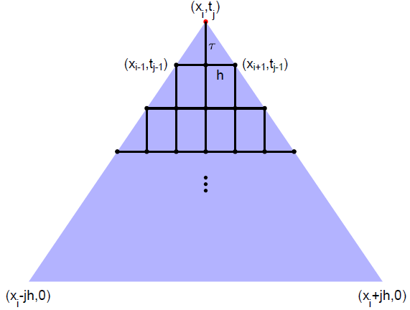
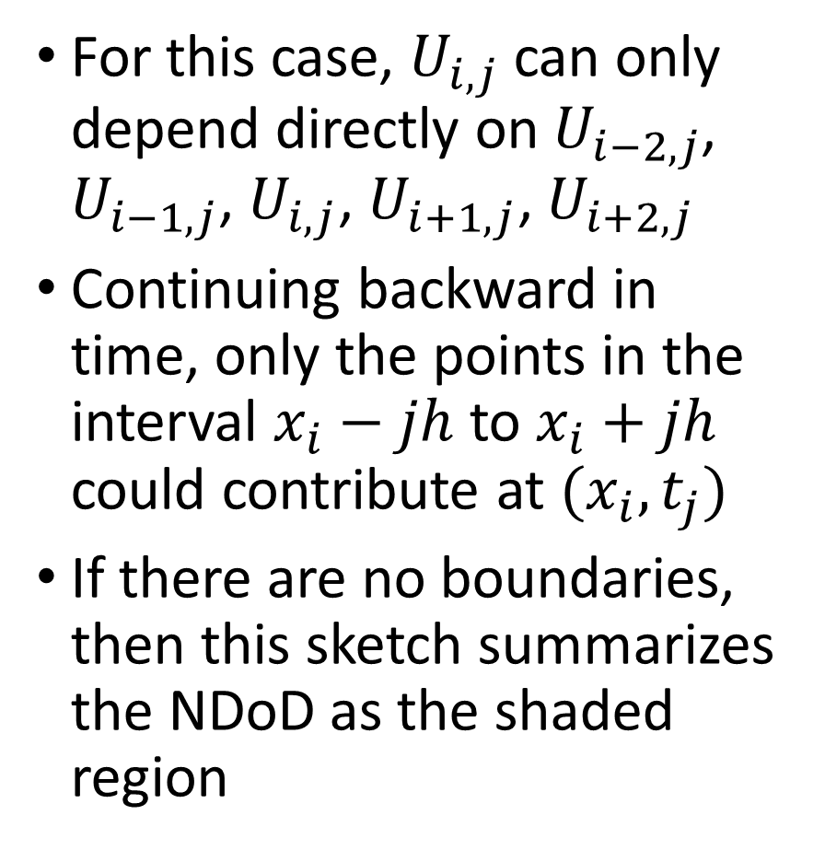
Upwinding and stability
For this case, $U_{i,j}$ can only depend directly on $U_{i−2,j}$, $U_{i−1,j}$, $U_{i,j}$, $U_{i+1,j}\text{, }U_{i+2,j}$
Continuing backward in time, only the points in the interval $x_{i}−jh$ to $x_{i}+jh$ could contribute at $(x_{i},t_{j})$
If there are no boundaries, then this sketch summarizes the NDoD as the shaded region

Slide 25

The CFL condition
In order for a numerical solution to converge to the correct solution, it must be that the NDoD contains the domain of dependence from the PDE solution
This is called the Courant-Friedrichs-Lewy condition or CFL condition
A plausibility argument is that the numerical method can’t possibly right if a change in initial condition in the exact (PDE) IC is not captured by the numerical method
By comparing the domain of dependence and the NDoD, we can derive that this requires

Slide 26
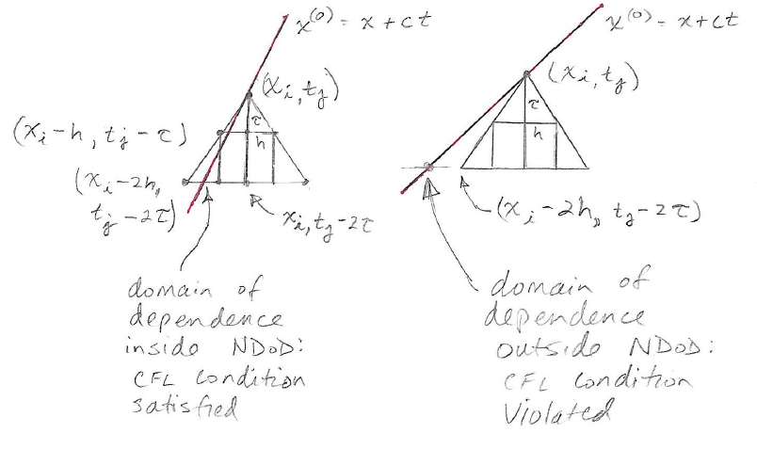
CFL condition

Slide 27
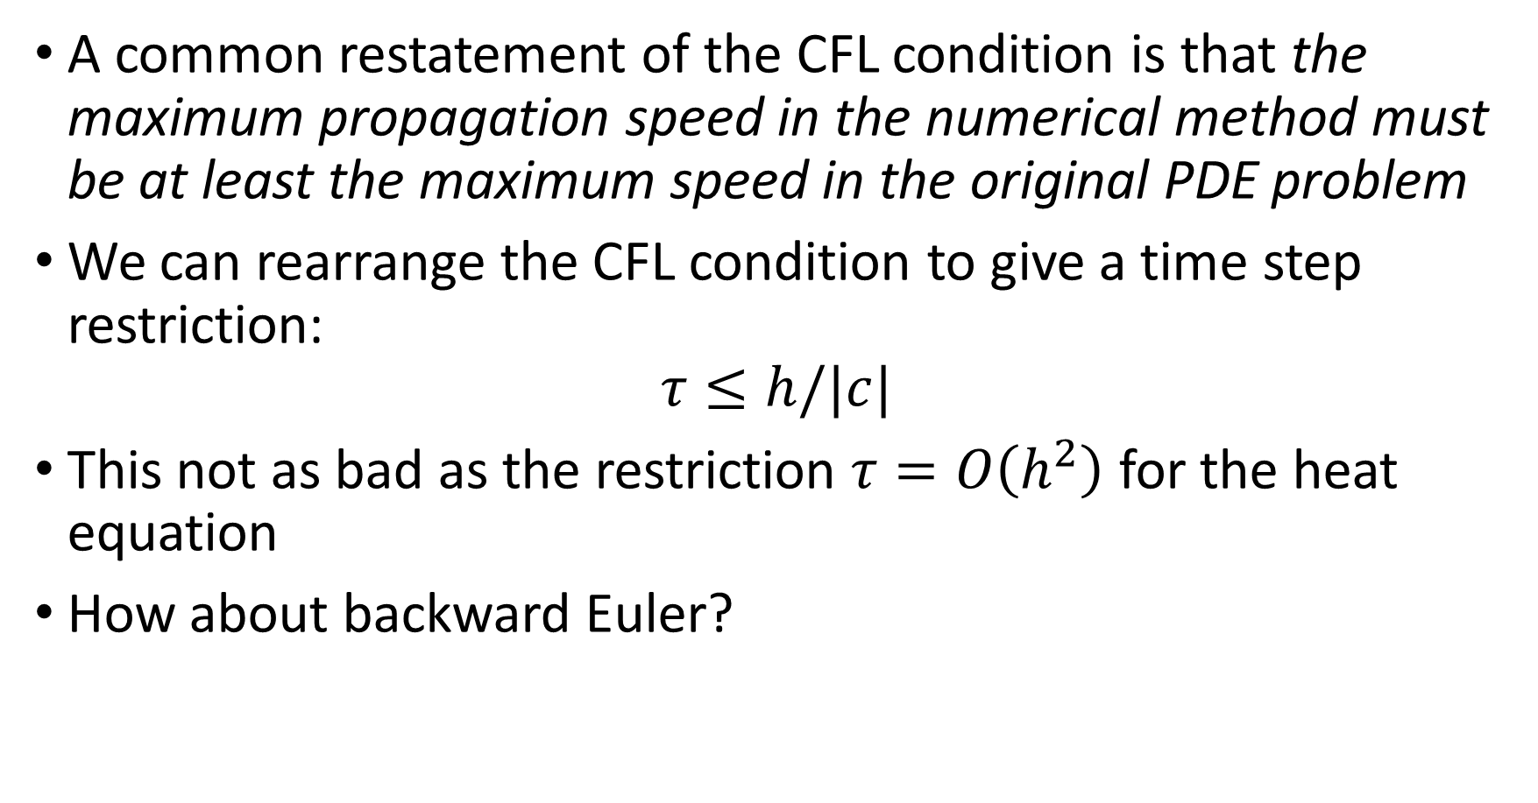
The CFL condition
A common restatement of the CFL condition is that the maximum propagation speed in the numerical method must be at least the maximum speed in the original PDE problem
We can rearrange the CFL condition to give a time step restriction:
$$τ≤h/|c|$$
This not as bad as the restriction $τ=O\left(h^{2}\right)$ for the heat equation
How about backward Euler?

Slide 28

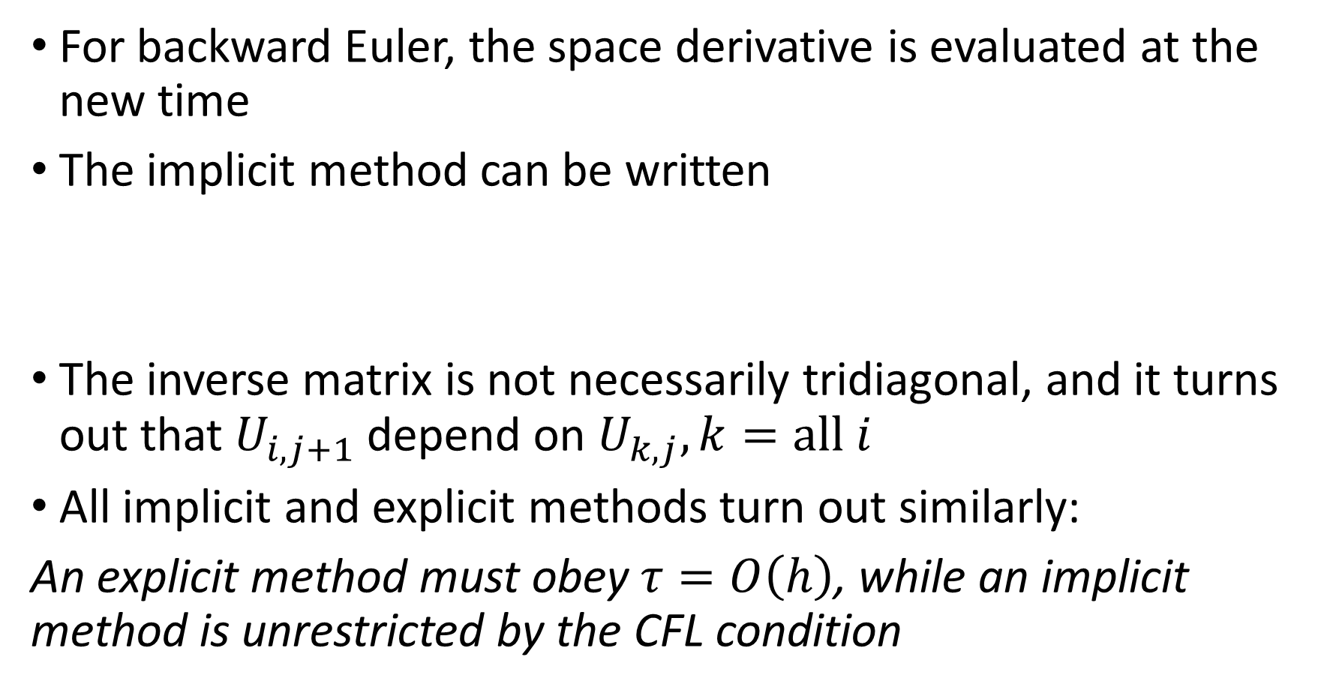
The CFL condition
For backward Euler, the space derivative is evaluated at the new time
The implicit method can be written
The inverse matrix is not necessarily tridiagonal, and it turns out that $U_{i,j+1}$ depend on $U_{k,j}, k=all i$
All implicit and explicit methods turn out similarly:
An explicit method must obey $τ=O\left(h\right)$, while an implicit method is unrestricted by the CFL condition

Slide 29


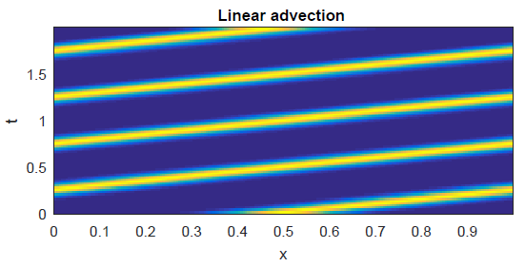
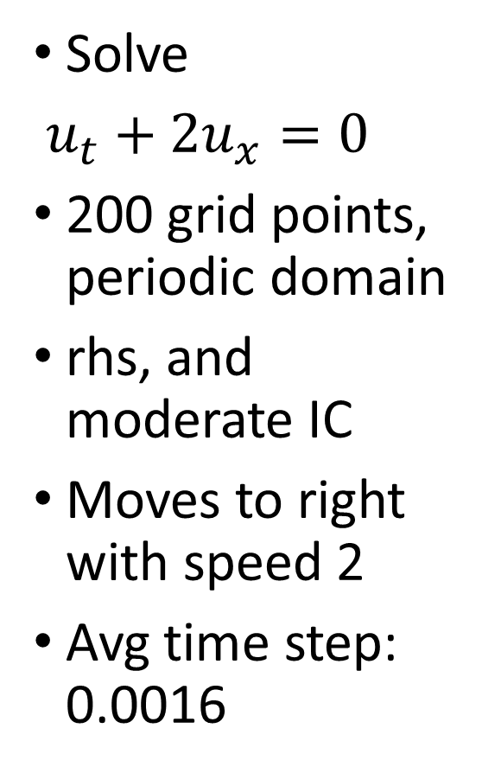
Example: CFL condition, linear advection
Solve
$u_{t}+2u_{x}=0$
200 grid points, periodic domain
rhs, and moderate IC
Moves to right with speed 2
Avg time step: 0.0016

Slide 30

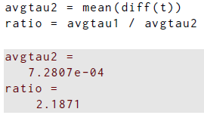
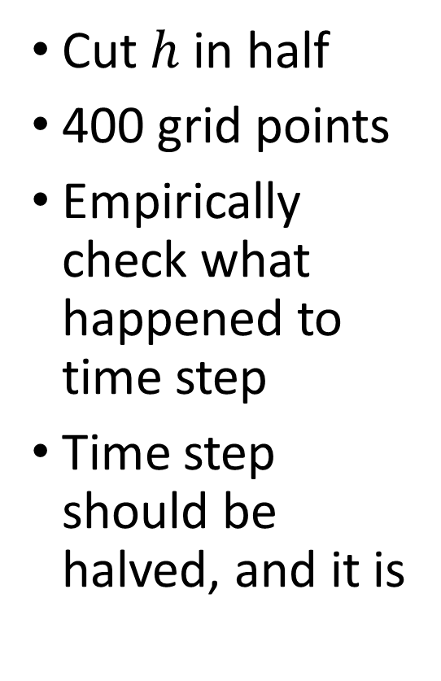
Example: CFL condition, linear advection
Cut $h$ in half
400 grid points
Empirically check what happened to time step
Time step should be halved, and it is

Slide 31
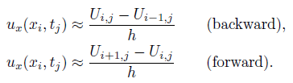
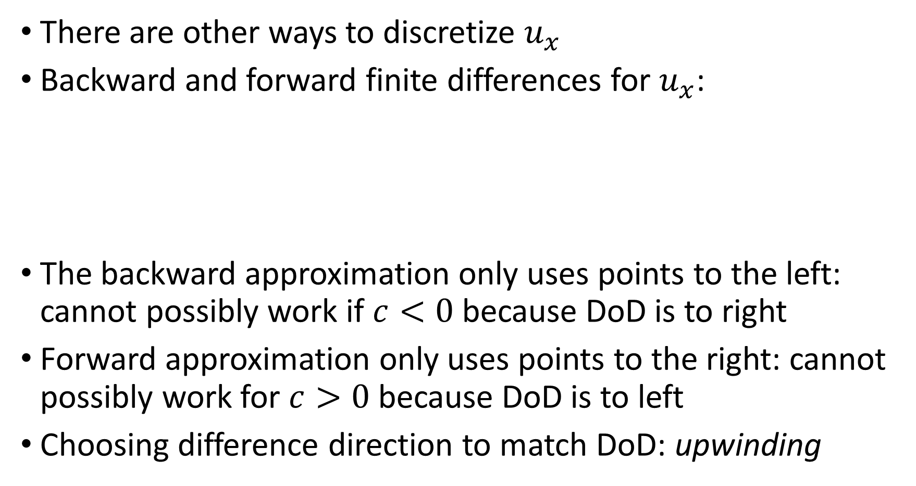
Upwinding and stability
There are other ways to discretize $u_{x}$
Backward and forward finite differences for $u_{x}$:
The backward approximation only uses points to the left: cannot possibly work if $c<0$ because DoD is to right
Forward approximation only uses points to the right: cannot possibly work for $c>0$ because DoD is to left
Choosing difference direction to match DoD: upwinding

Slide 32
Upwinding and stability
Boundary conditions must be specified on the upwind side
If they are, the PDE in the interior “doesn’t know” about the specified boundary value
The boundary condition at the upwind side is often called an inflow condition in the context of fluid dynamics
Here’s an example…

Slide 33

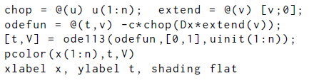
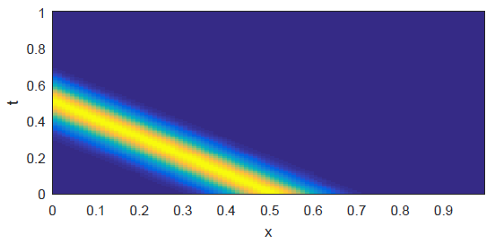
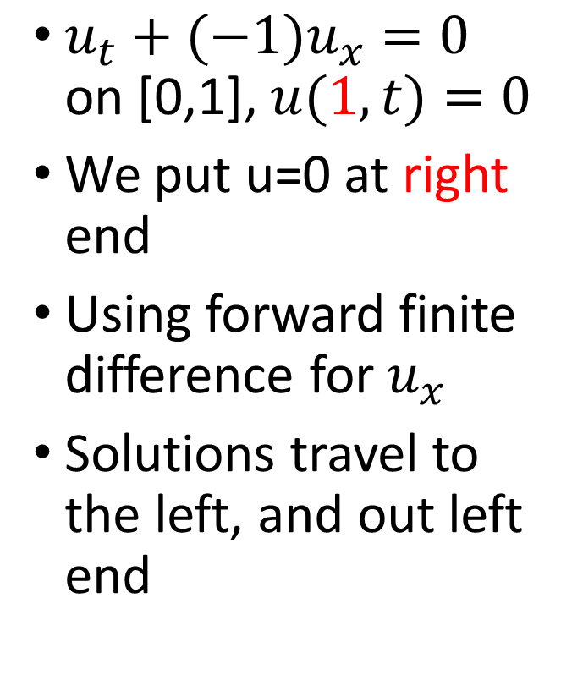
Example: BCs and upwinding
$u_{t}+(−{1)u}_{x}=0$ on [0,1], $u(1,t)=0$
We put u=0 at right end
Using forward finite difference for $u_{x}$
Solutions travel to the left, and out left end

Slide 34

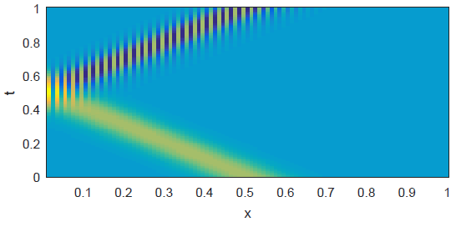
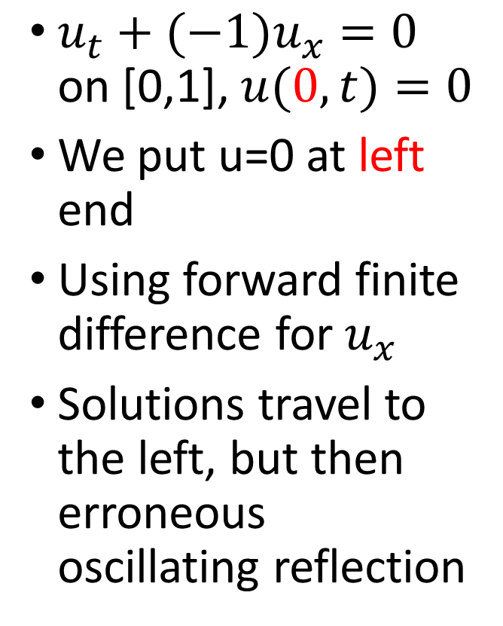
Example: BCs and upwinding
$u_{t}+(−{1)u}_{x}=0$ on [0,1], $u(0,t)=0$
We put u=0 at left end
Using forward finite difference for $u_{x}$
Solutions travel to the left, but then erroneous oscillating reflection

Slide 35
Section 12.3 Absolute stability for advection

Slide 36
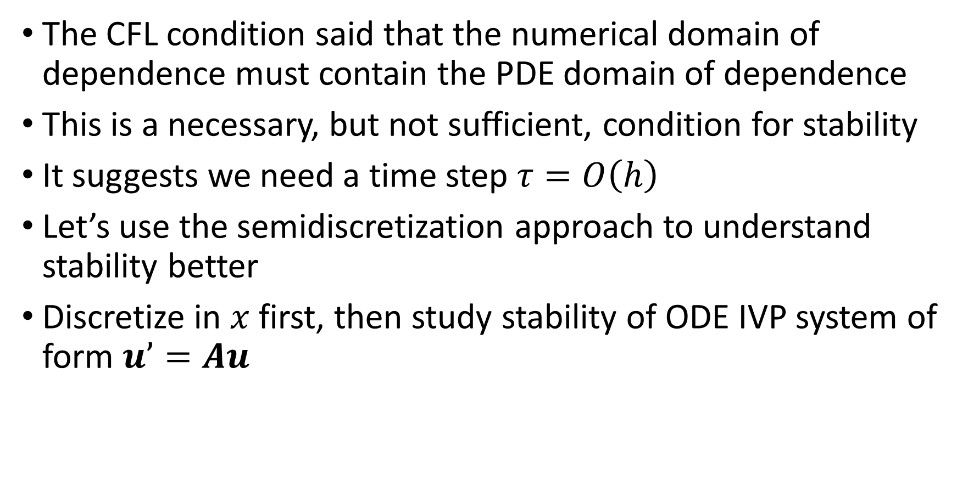
Absolute stability for advection
The CFL condition said that the numerical domain of dependence must contain the PDE domain of dependence
This is a necessary, but not sufficient, condition for stability
It suggests we need a time step $τ=O\left(h\right)$
Let’s use the semidiscretization approach to understand stability better
Discretize in $x$ first, then study stability of ODE IVP system of form $u’=Au$

Slide 37
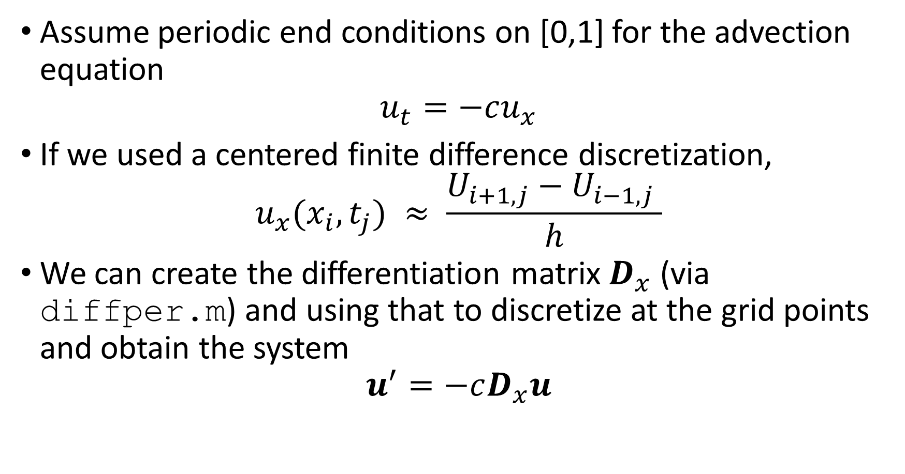
Absolute stability for advection
Assume periodic end conditions on [0,1] for the advection equation
$$u_{t}=−cu_{x}$$
If we used a centered finite difference discretization,
$$u_{x}(x_{i},t_{j}) ≈ \frac{U_{i+1,j}−U_{i−1,j} }{h}$$
We can create the differentiation matrix $D_{x}$ (via diffper.m) and using that to discretize at the grid points and obtain the system
$$u^{′}=−cD_{x}u$$

Slide 38

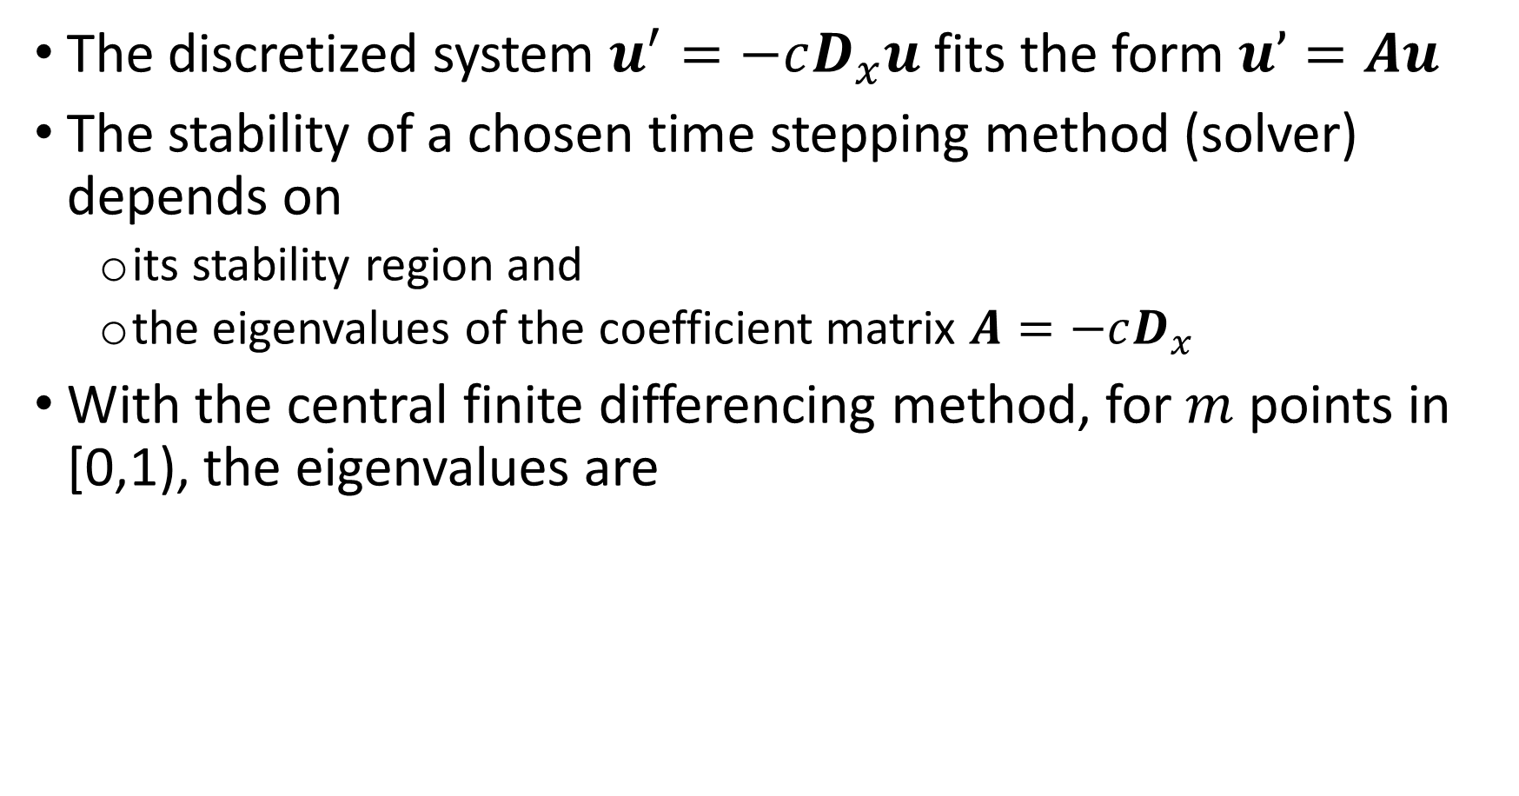
Absolute stability for advection
The discretized system $u^{′}=−cD_{x}u$ fits the form $u’=Au$
The stability of a chosen time stepping method (solver) depends on
its stability region and
the eigenvalues of the coefficient matrix $A=−cD_{x}$
With the central finite differencing method, for $m$ points in [0,1), the eigenvalues are

Slide 39
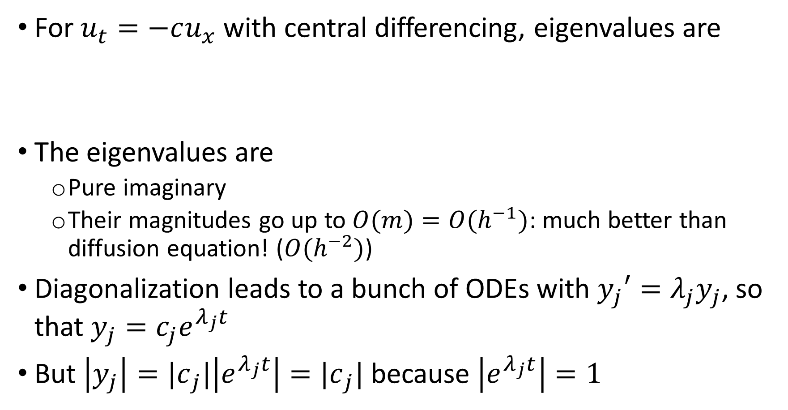
Absolute stability for advection
For $u_{t}=−cu_{x}$ with central differencing, eigenvalues are
The eigenvalues are
Pure imaginary
Their magnitudes go up to $O(m)=O(h^{−1})$: much better than diffusion equation! ($O(h^{−2})$)
Diagonalization leads to a bunch of ODEs with $y_{j}′=λ_{j}y_{j}$, so that $y_{j}=c_{j}e^{λ_{j}t}$
But $\left|y_{j}\right|={|c}_{j}|\left|e^{λ_{j}t}\right|={|c}_{j}|$ because $\left|e^{λ_{j}t}\right|=1$

Slide 40
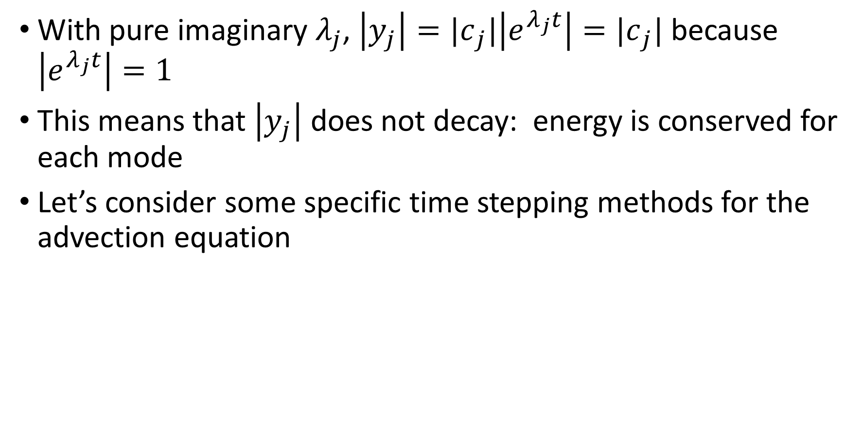
Absolute stability for advection
With pure imaginary $λ_{j}$, $\left|y_{j}\right|={|c}_{j}|\left|e^{λ_{j}t}\right|={|c}_{j}|$ because $\left|e^{λ_{j}t}\right|=1$
This means that $\left|y_{j}\right|$ does not decay: energy is conserved for each mode
Let’s consider some specific time stepping methods for the advection equation

Slide 41

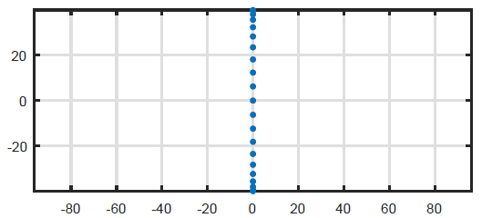
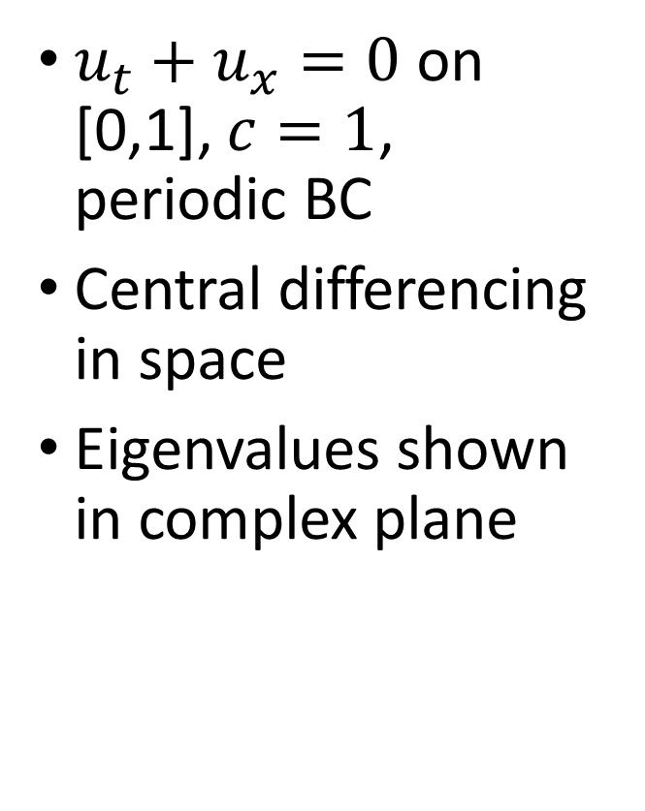
Example: advection and stability
$u_{t}+u_{x}=0$ on [0,1], $c=1$, periodic BC
Central differencing in space
Eigenvalues shown in complex plane

Slide 42
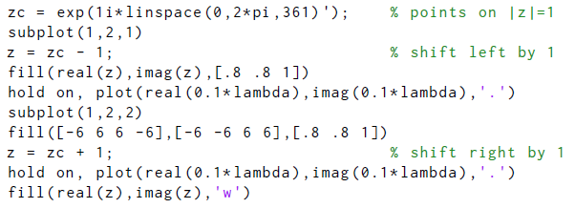
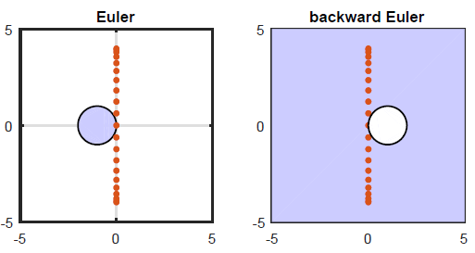
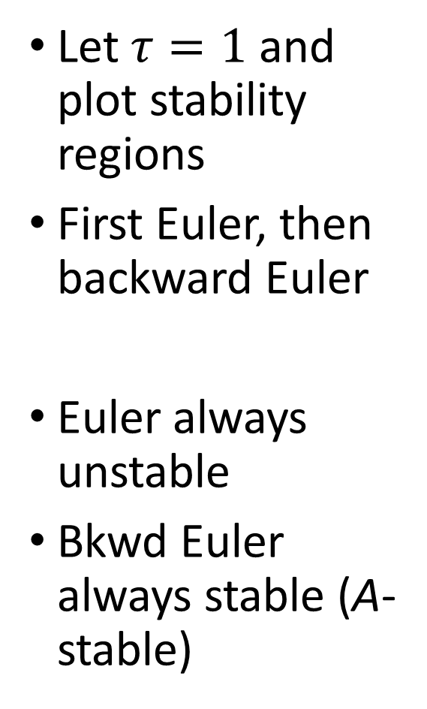
Example: advection and stability
Let $τ=1$ and plot stability regions
First Euler, then backward Euler
Euler always unstable
Bkwd Euler always stable (A-stable)

Slide 43
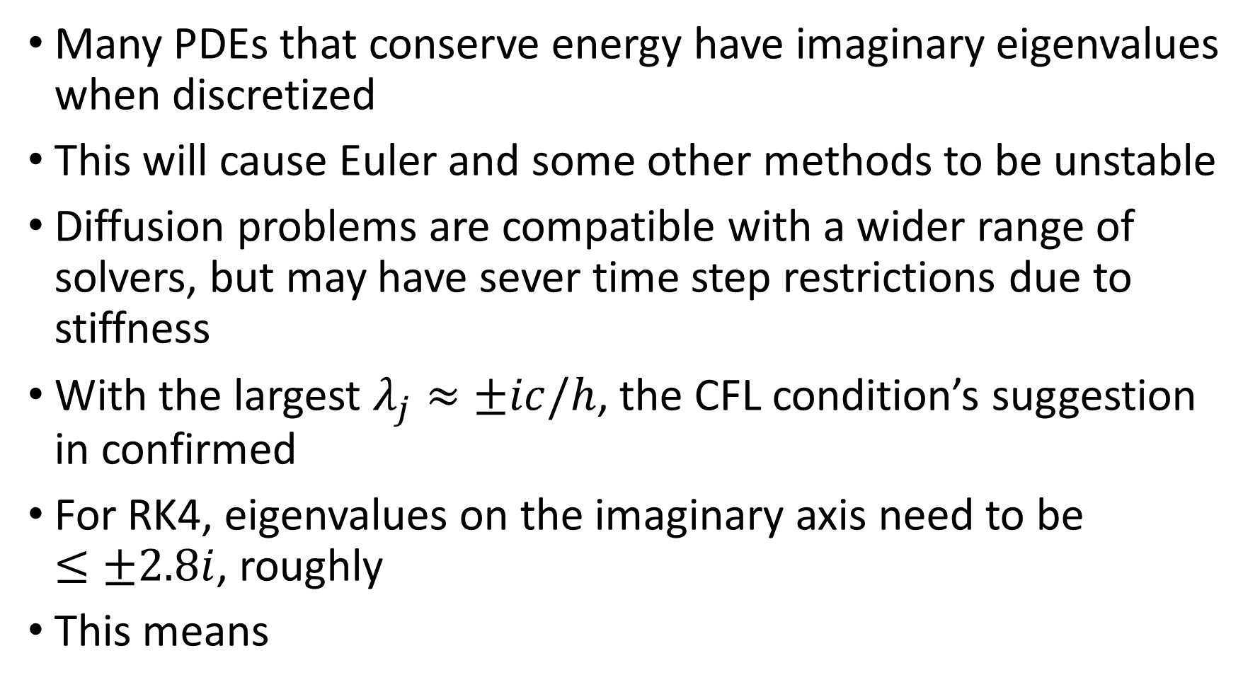
Absolute stability for advection
Many PDEs that conserve energy have imaginary eigenvalues when discretized
This will cause Euler and some other methods to be unstable
Diffusion problems are compatible with a wider range of solvers, but may have sever time step restrictions due to stiffness
With the largest $λ_{j}≈±ic/h$, the CFL condition’s suggestion in confirmed
For RK4, eigenvalues on the imaginary axis need to be $≤±2.8i$, roughly
This means

Slide 44


Advection and stability : RK4
Upper limit of stability is $2.8i$
Eigenvalues from ODE system must be smaller
Limits time step to $O(h)$, in this case $τ≤2.8h/c$
Better than $O(h^{2})$

Slide 45

Advection-diffusion equations
A common situation is to combine advection and diffusion
Assume periodic end conditions on [0,1], and the linear advection-diffusion equation
$$u_{t}+cu_{x}=εu_{xx}$$
The parameter $ε$ is a constant that controls the relative strength of diffusion
If $ε=0$, then pure imaginary as in advection
If $ε=O(1)$, may have large negative real parts in some eigenvalues
The stability should depend strongly on $ε$

Slide 46



Example: advection-diffusion eqns
$u_{t}+u_{x}=εu_{xx}$ on [0,1], $c=1$, periodic BC
$τ=0.1$ here
Eigenvalues show strong dependence $ε$
Choose time solver based on parameters

Slide 47

Boundary effects
The boundary conditions can dramatically affect the eigenvalues in a discretized system
This can in turn affect the stability of a given solver
Assume this linear advection equation is on [0,1]:
$$u_{t}+u_{x}=0$$
Assume the homogenous inflow condition $u(0,t)=0$
In section 11.5, we derived an ODE IVP system for the interior dependent variables
$$v^{′}=f(t,v)$$
$v$ has $m$ elements, and excludes the solution at $x=0$

Slide 48



Boundary effects
Let $E$ be the $(m+1)×(m+1)$identity matrix with the first row deleted
Let $u$ be the unknowns at all $m+1$ grid points
Then, $v=Eu$ are the interior unknowns
Also, $v′=Eu′$
Then,
Put this in the ODE system:

Slide 49

Boundary effects
To look at eigenvalues, we thus need to study $A=−ED_{x}E^{T}$
In words, we need to study $D_{x}$ with its first row and column removed
This is trivial for a finite difference approximation, but slightly less so for a Chebyshev discretization, say
This is the done in the following example

Slide 50




Example: advection with inflow BC
$u_{t}+u_{x}=0$ on [0,1], $c=1$, inflow BC
Eigenvalues all negative: solution becomes zero everywhere
Computed before

Slide 51
Section 12.4 The wave equation

Slide 52



The wave equation
We now consider the (second order) wave equation
This equation has solutions of both forms $φ(x−ct)$ and $φ(x+ct)$
It allows propagation in both directions at once!
We need two BCs and two ICS:

Slide 53


The wave equation
We could discretize it directly with centered differences:
Needs two old time levels: $j$ and $j−1$ are needed for $j+1$
Explicit for $U_{i,j+1}$
But, we will take a different approach…
Write the a first order system, and solve that…

Slide 54



The wave equation: first order system
Let $y = u_{t}$, then
But, another way turns out to be good
Let $u_{t}=z_{x}$ and consider equations for $u(x,t)$ and $z(x,t)$:
We can change the IC to

Slide 55


First order system
We now apply semidiscretization to
Using centered differences since waves can go both ways
Discretizing in space gives, as usual,
The BCs say we should chop off $u$ at the ends, but keep $z$ there
We can do this with dedicated extend and chop functions
Let the unknowns without the end $u$ values be $w$

Slide 56




Example: 1st order wave eqn system
$u_{tt}=2u_{xx}$ on [-1,1], $c=2$
Only need first derivative matrix
Compute needed derivatives and assemble rhs function for ODE system

Slide 57




Example: 1st order wave eqn system
Set up Ics
Hyperbolic PDE is not stiff, so we can use ode45
Extract original variables to plot

Slide 58


Example: 1st order wave eqn system
Initial $u$ bump splits
Bigger one to right
Both speed $c=2$
Reflecting from boundary flips over

Slide 59

Reflections: variable wave speed
We have seen that boundaries with homogeneous Dirichlet conditions reflect waves
And, the reflection, that is the wave leaving the boundary, is inverted compared to the wave that approaches the boundary
It turns out that if the wave speed $c$ depends on $x$, namely $c(x)$, then there can also be reflections
We demonstrate with an example.

Slide 60

The wave equation: first order system
We consider
The system is on [-1,1], with $u(−1,t)=u(1,t)=0$and $u(x,0)=f(x)$and $z(x,0)=g(x)$.
Here $f\left(x\right)=\exp\left( −100x^{2}\right), g\left(x\right)=−f(x)$.
We now have $c(x) = 1 + ( sign(x) +1) /2$; this is 1 for $x<0$ and 2 for $x>0$
Solve again…

Slide 61



Example: variable wave speed
Set up differentiation
Set up variable wave speed
Set up rhs function of ODE system

Slide 62


Example: variable wave speed
Set up ICs and solve system with ode45
Extract original variables and plot

Slide 63

Example: variable wave speed
Discontinuous wave speed at zero reflects wave
Happens at each pass of wave
Gets complicated!

Slide 64
Key ideas
Exact solutions to the advection equation propagate in one direction and constant speed and do not change shape
Nonlinear problems can depend on the solution values themselves, which allows much richer behavior (e.g. shocks)
The CFL condition requires that explicit time stepping have a time step comparable to the space step for stability. This requirement also motivates the use of upwinding.
The wave equation, which is second order in both space and time, allows propagation of waves in both directions. This led to the use of central differencing in space, which acted as upwinding in both directions.

